Slide 1



DevOps Final Presentation
Made by:
Omar Barakat​
Mohamed Samy
Bola Wagdy ​
Mustafa Ali
Thomas Sedhom

Slide 2



Team Members

Slide 3
Table of Contents
1
2
3
4
Introduction
Projects
Introduction about our presentation
Projects in a nutshell
Tools
Summary
All tools to be discussed
Recap of our presentation

Slide 4
1
Introduction

Slide 5
What is DevOps ?
DevOps is a set of practices, tools, and a cultural philosophy that automate and integrate the processes between software development and IT teams.

Slide 6
Why DevOps ?
It emphasizes team empowerment, cross-team communication and collaboration, and technology automation.

Slide 7
Source Code
Version Control
Infrastructure as Code
Provisioning
Configuration Management
Code
Deploy
Plan
Development
Automation
Build
Dev
Release
Ops
Virtualization
Containerization
Operate
Plan
Test
Monitor
Continuous Integration/ Continuous Delivery or Deployment (CI/CD)
Visualisations
Logging
Quality Control

Slide 8
2
Projects
Projects in a Nutshell

Slide 9
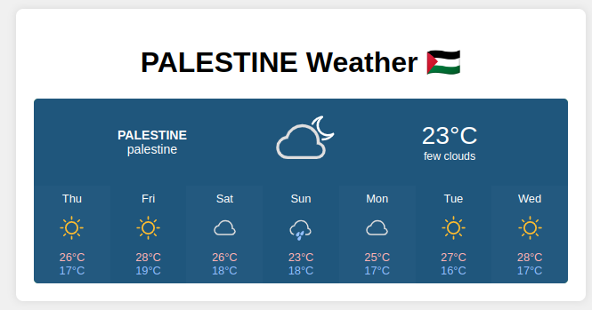
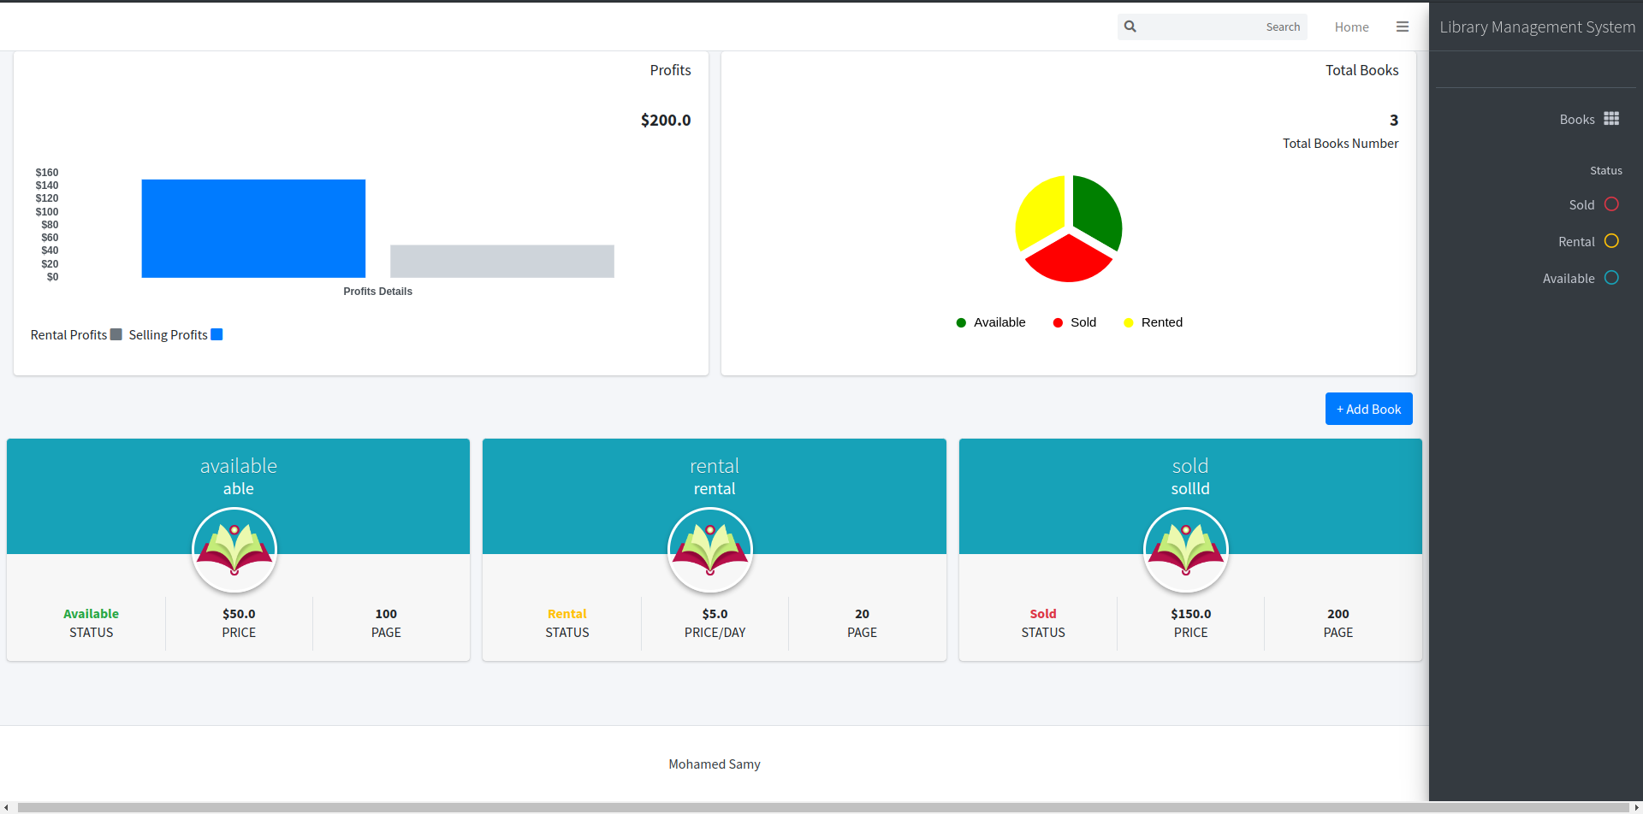
Samy’s Project
Mustafa’s Project

Slide 10
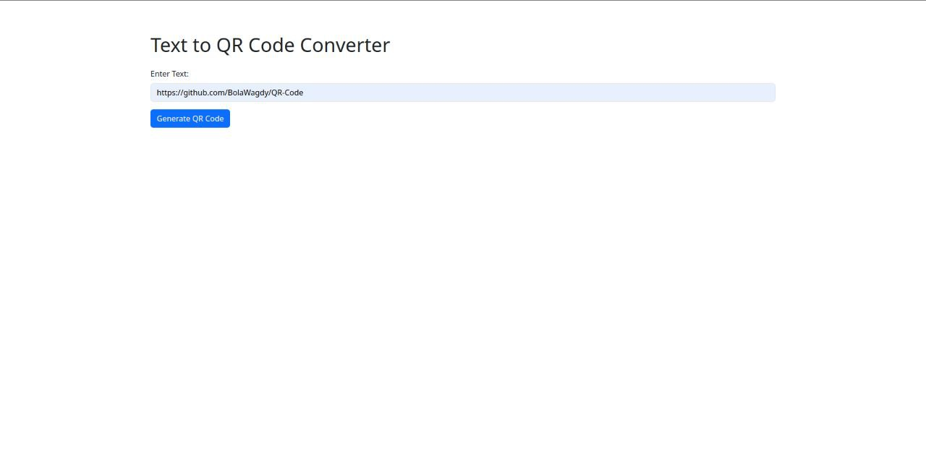
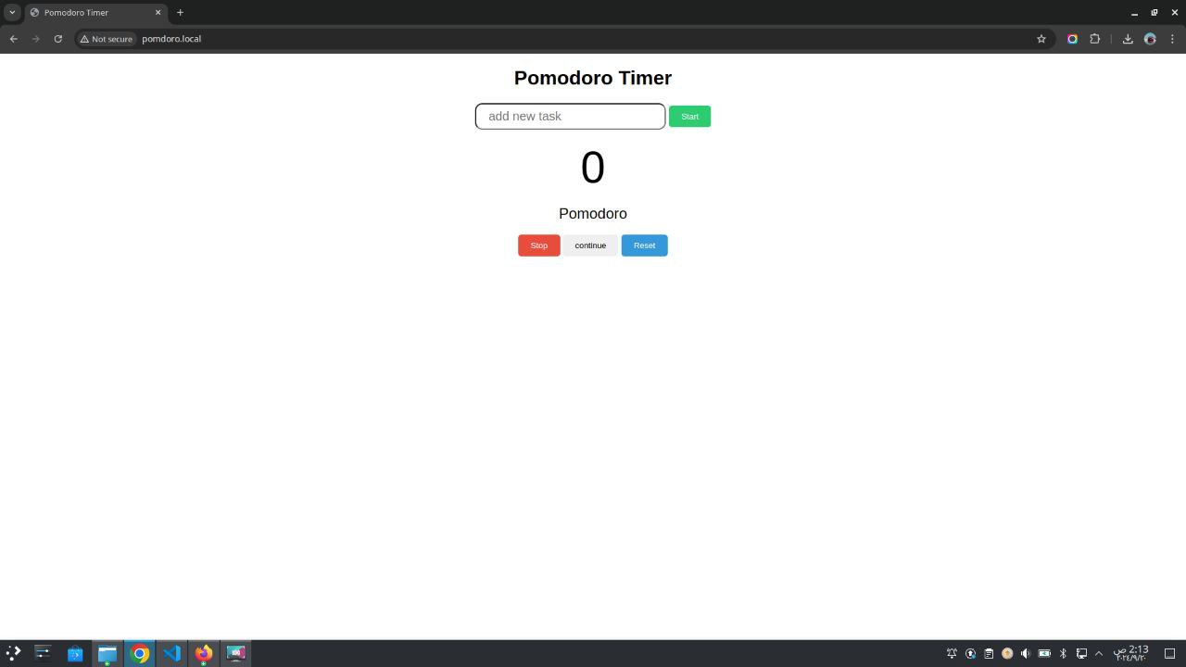
Thomas’s Project
Bola’s Project

Slide 11
Barakat’s Project

Slide 12
3
Tools
Getting into the tools

Slide 13

Flask Web Project
Code
Deploy
Plan
Build
Release
Operate
Plan
Test
Monitor
Lightweight web framework for building web applications.
Microservices-friendly architecture.
Easy to integrate with APIs and backend services.
Supports rapid development and deployment of RESTful services.
Commonly used in combination with Docker for containerization.

Slide 14

GitHub
Code
Deploy
Plan
Build
Release
Operate
Plan
Test
Monitor
Centralized platform for version control using Git.
Facilitates collaboration through pull requests, code reviews, and branching strategies.
Integrates seamlessly with GitHub Actions for CI/CD automation.
Supports issue tracking, project management, and documentation via GitHub Projects and GitHub Wiki.
Enables collaboration across teams with private/public repositories and role-based access control.
Provides a platform for open-source contributions and project visibility.

Slide 15
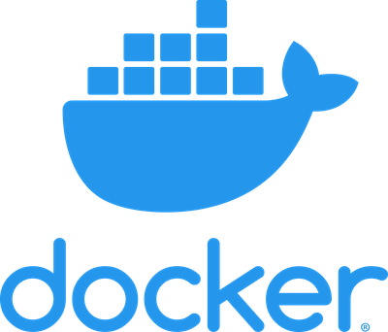
Docker
Code
Deploy
Plan
Build
Release
Operate
Plan
Test
Monitor
Packages applications into containers for consistency across environments.
Ensures that the application runs the same way in development, testing, and production.
Simplifies dependencies and system configurations.
Works seamlessly with CI/CD pipelines for automated builds and testing.
Integral for microservices-based architectures.

Slide 16
Code
Deploy
Plan
Build
Release
Operate
Plan
Test
Monitor
Omar Barakat's Repo

Slide 17
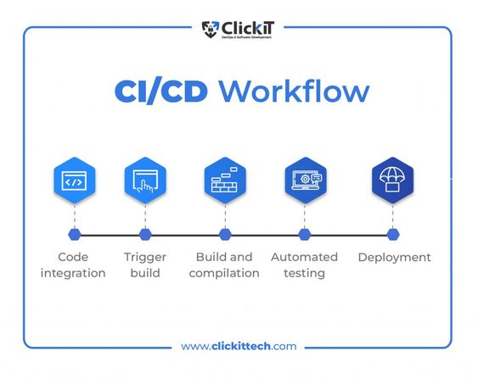
Code
Deploy
Plan
Build
Release
Operate
Situation of Continuous Integration (CI):
Imagine a team of developers working on a web application. Each developer works on different features and bug fixes in separate branches. Without CI, integrating these changes into the main branch can be chaotic and error-prone, leading to integration issues and bugs.
Definition of Continuous Integration (CI):
Continuous Integration (CI) is a software development practice where developers frequently integrate their code changes into a shared repository, usually several times a day.
CI Tools: GitHub Actions and Jenkins:
Plan
Test
Monitor

Slide 18
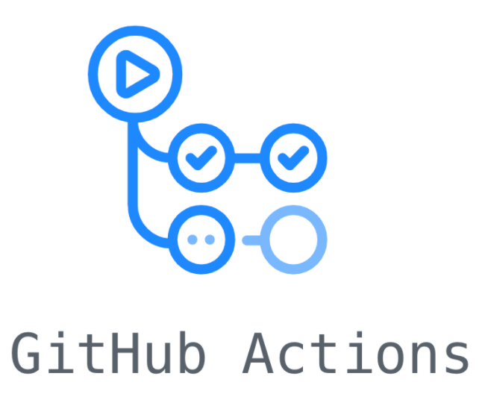
GitHub Actions
Code
Deploy
Plan
Release
Operate
Build
Plan
Test
Monitor
GitHub Actions is a CI/CD tool integrated directly into GitHub.
It allows you to automate workflows for your repository.
Wroten by YAML syntax.
Specifying triggers (events), jobs, and steps to execute.
Integrated with Docker and Kubernetes for continuous deployment.

Slide 19
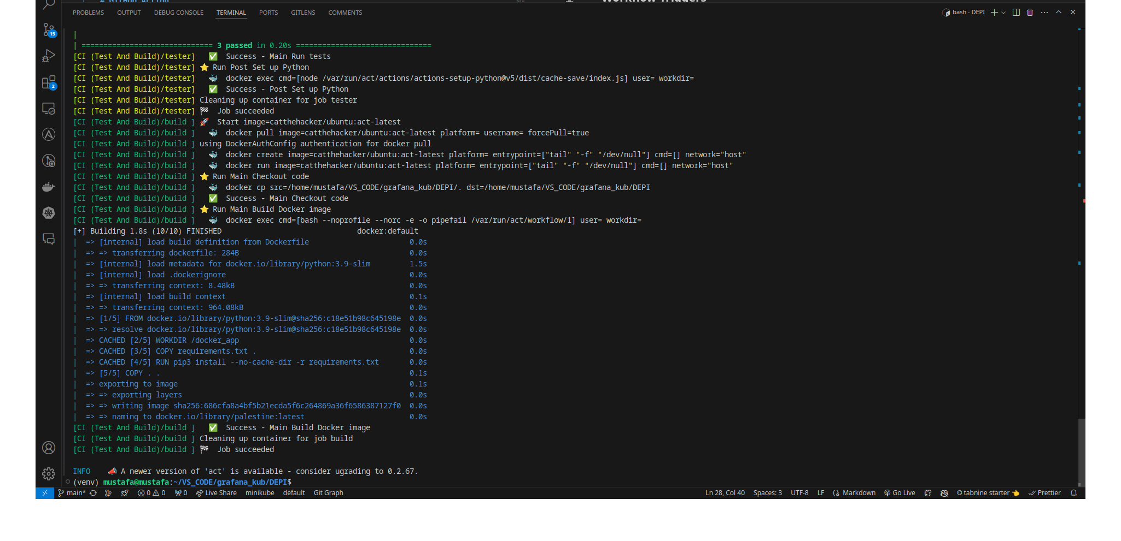

Slide 20
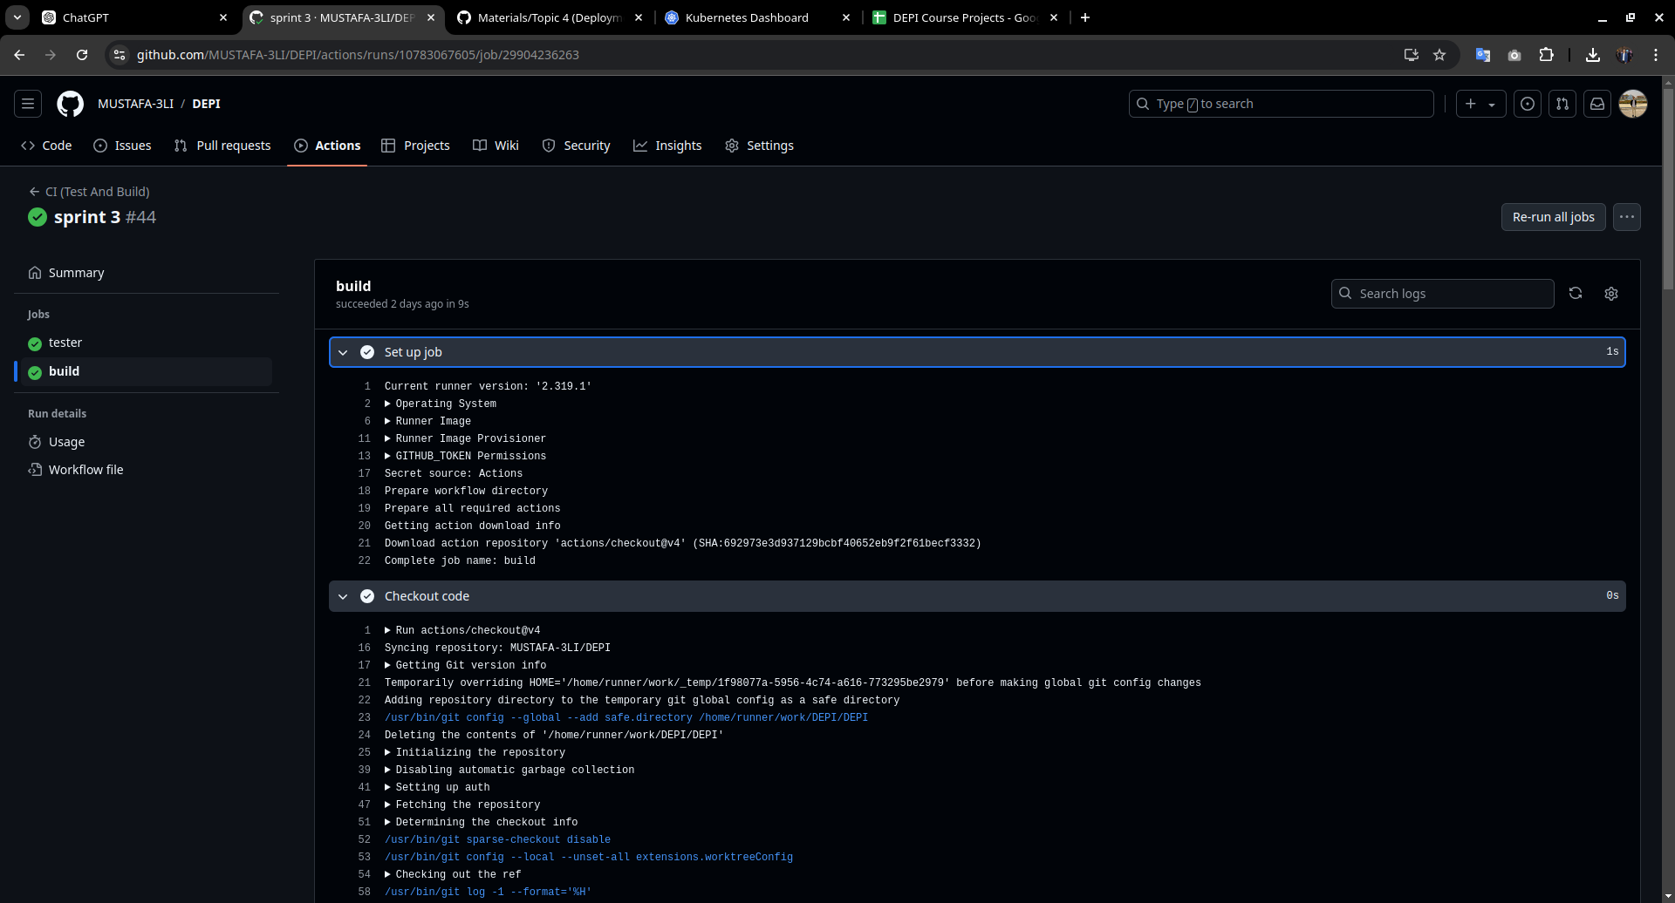

Slide 21

Jenkins
Code
Deploy
Plan
Build
Release
Operate
Plan
Test
Monitor
Automates the entire CI/CD process (build, test, and deploy).
Highly customizable with plugins to integrate with various DevOps tools.
Manages complex pipelines, including multi-stage and multi-branch workflows.
Supports integration with Docker, Kubernetes, and AWS for seamless deployment.
Scales across multiple agents for parallel builds and deployments.

Slide 22
Code
Deploy
Plan
Build
Release
Operate
Plan
Test
Monitor
Mustafa Ali's Repo

Slide 23
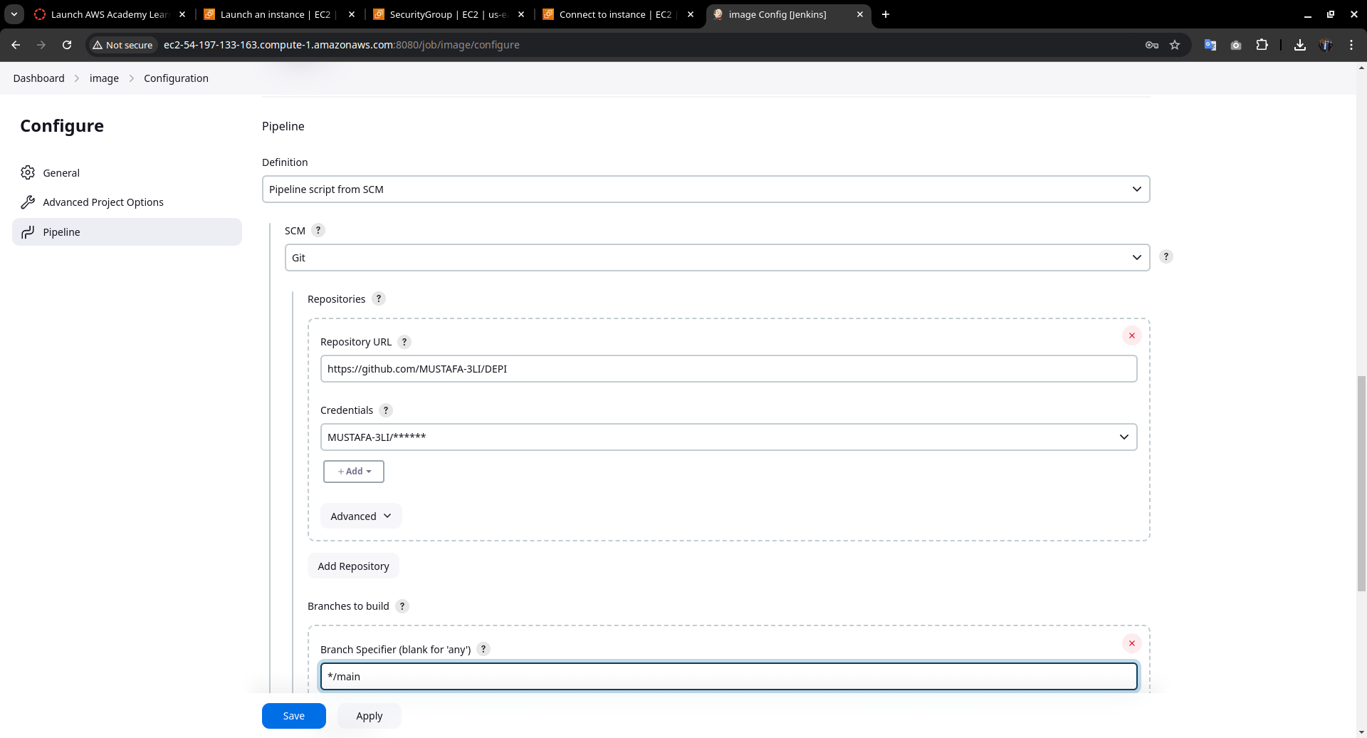

Slide 24
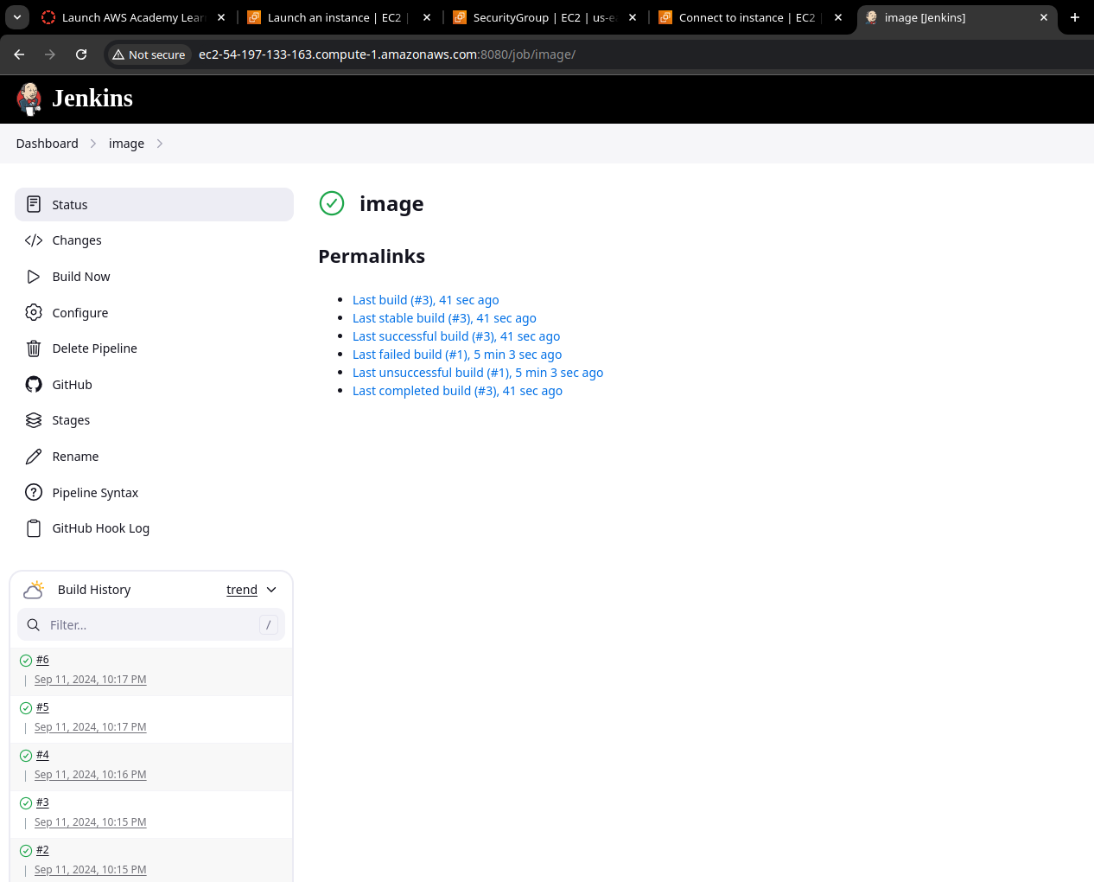

Slide 25
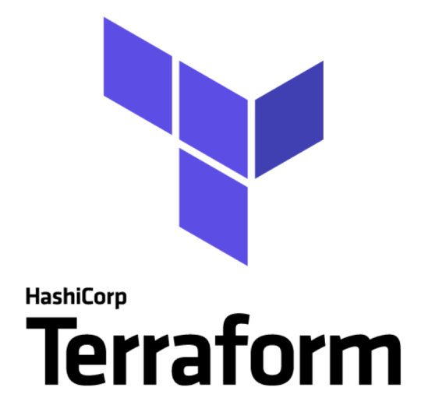
Terraform
Code
Deploy
Plan
Release
Operate
Build
Plan
Test
Monitor
Provisions infrastructure in a declarative, version-controlled way.
Supports multi-cloud environments, including AWS, GCP, and Azure.
Manages infrastructure as code, reducing manual errors.
Automates the creation, modification, and deletion of infrastructure components.
Scalable for small to large infrastructures, including VPCs, EC2, RDS, and more.

Slide 26
Code
Deploy
Plan
Build
Release
Operate
Plan
Test
Monitor
Bola Wagdy's Repo

Slide 27
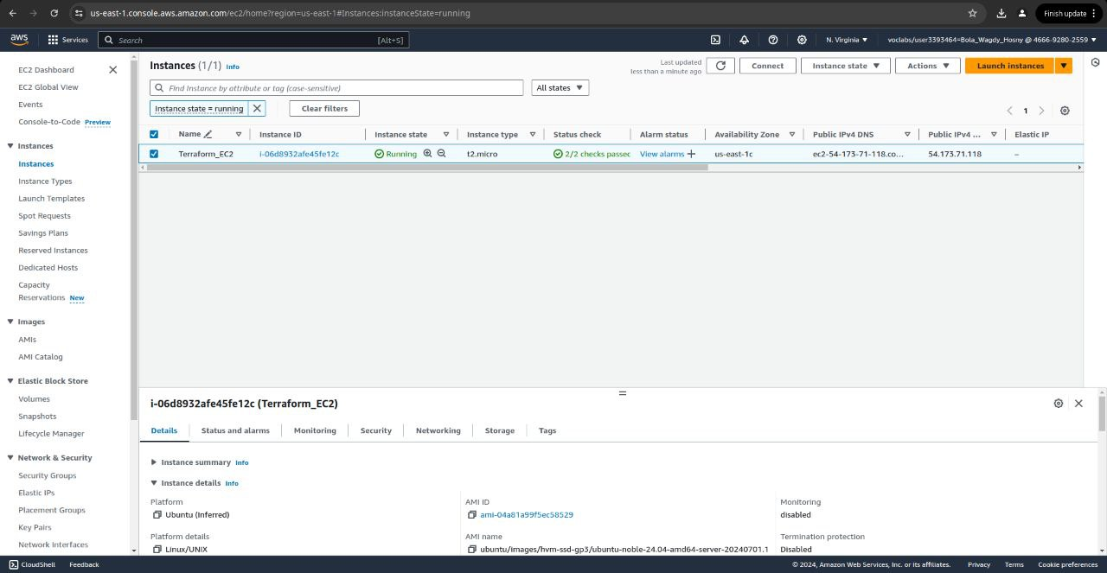

Slide 28

Ansible
Code
Deploy
Plan
Build
Release
Operate
Plan
Test
Monitor
Why Ansible, Not Terraform?
Focus Areas
Agentless
What is Ansible?
Ansible is an open-source automation tool that simplifies IT tasks like configuration management, application deployment, orchestration, and task automation.
What is the Core Unit of Ansible?

Slide 29
Code
Deploy
Plan
Build
Release
Operate
Plan
Test
Monitor
Thomas Sedhom's Repo

Slide 30
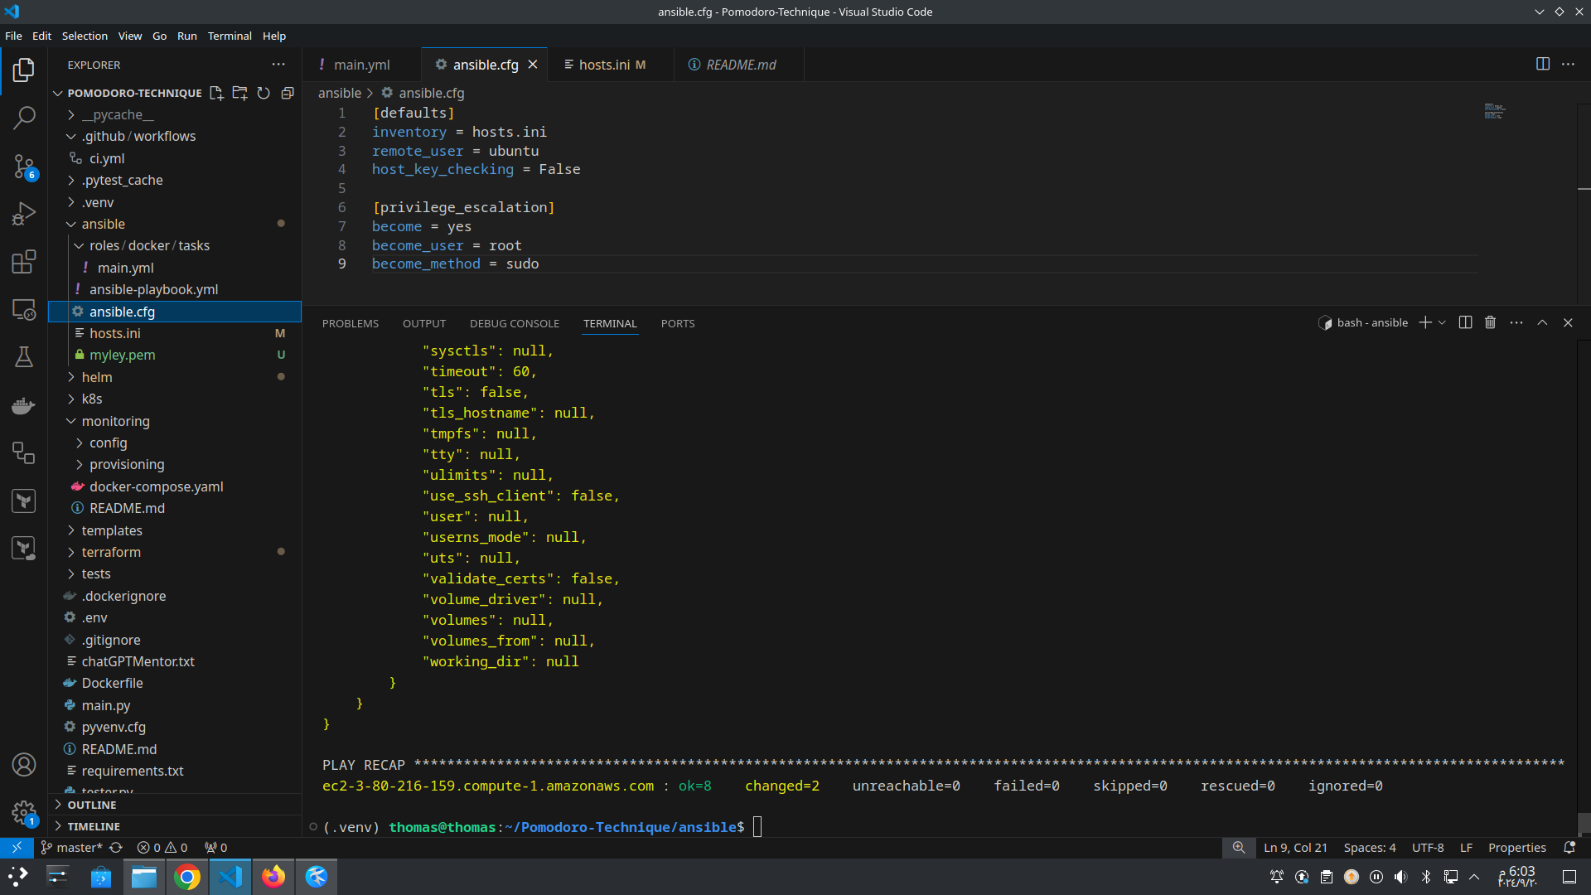

Slide 31
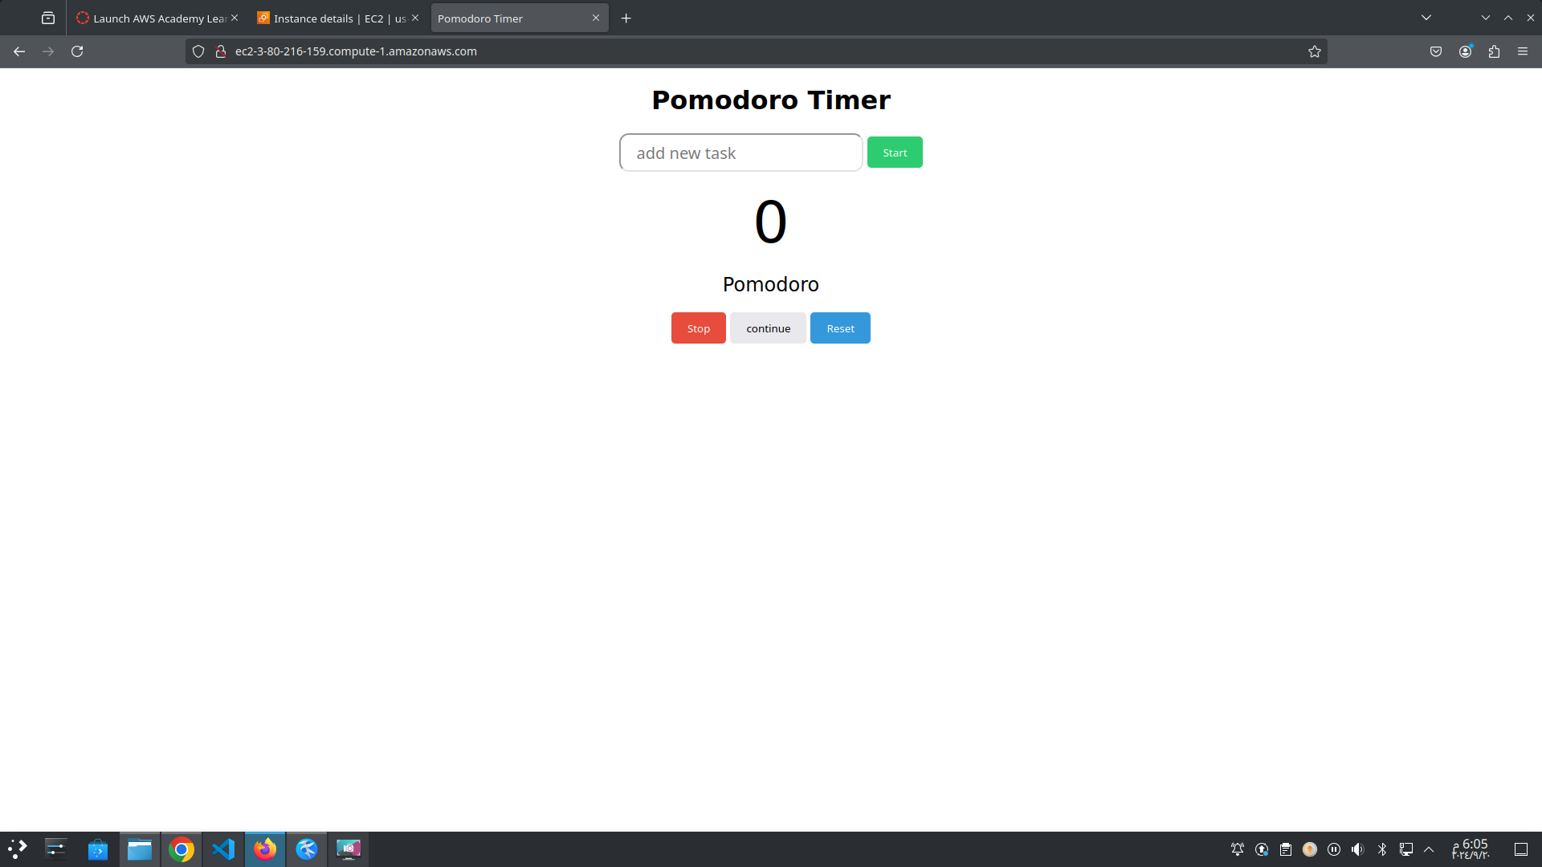

Slide 32
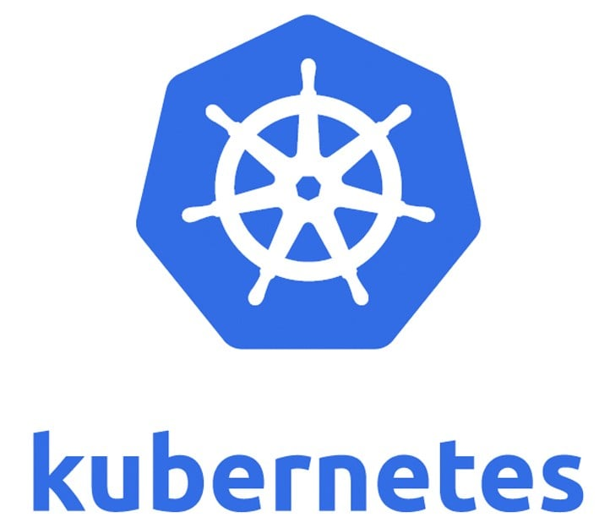
Kubernetes (container orchestration)
Code
Deploy
Plan
Release
Build
Operate
Plan
Test
Monitor
Manages, scales, and orchestrates containers across clusters.
Supports automated rollouts, rollbacks, and scaling of applications.
Monitors and ensures Self-healing (restarts failed containers).
Ideal for running microservices-based applications in production.
Load Balancing, Kubernetes distributes traffic among containers to ensure optimal resource use.

Slide 33
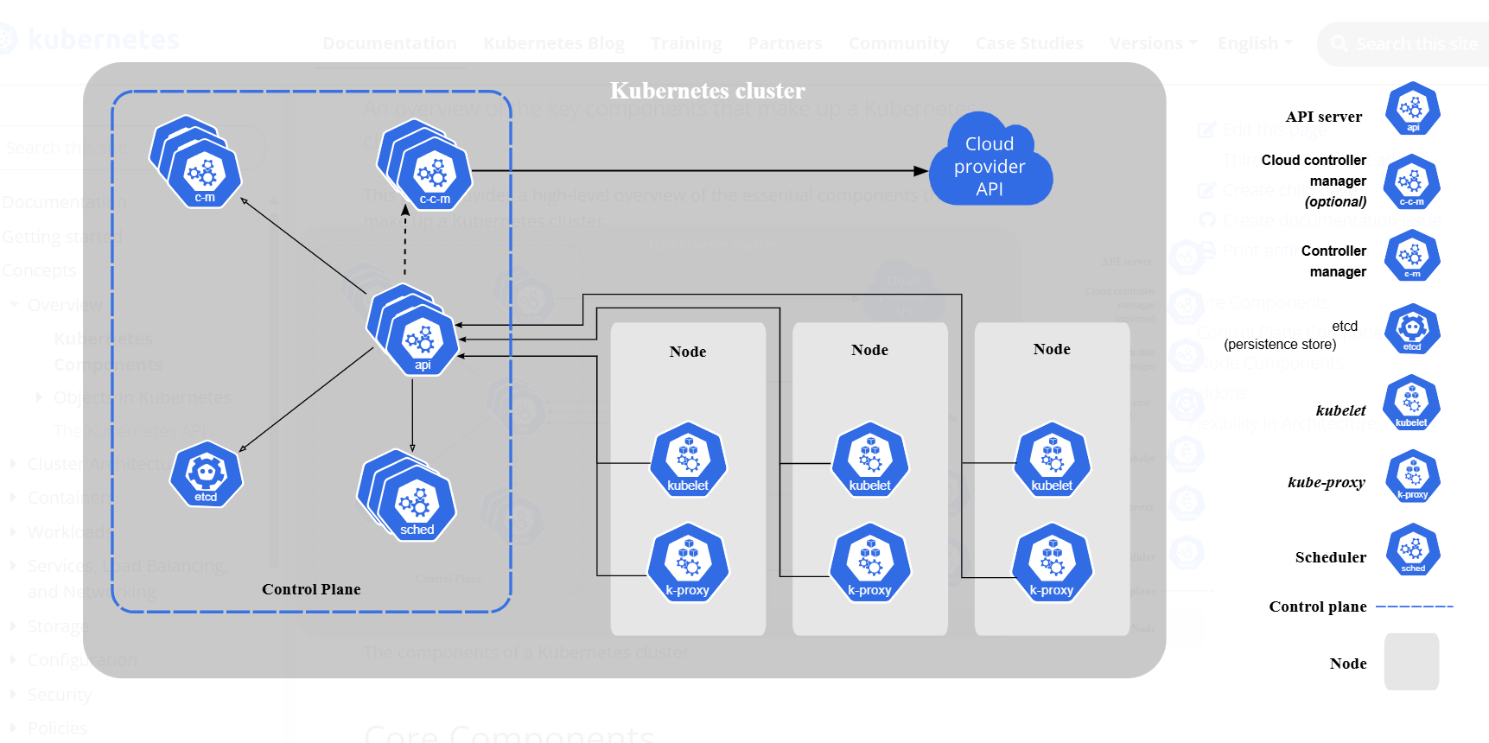

Slide 34
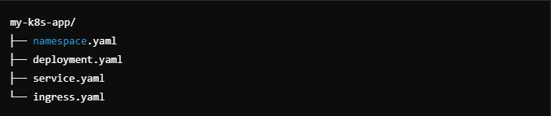
Kubernetes File Structure

Slide 35
Code
Deploy
Plan
Build
Release
Operate
Plan
Test
Monitor
Mohamed Samy's Repo

Slide 36

Helm
Code
Deploy
Plan
Build
Release
Operate
Plan
Test
Monitor
Helm is a package manager for Kubernetes that simplifies the deployment of applications by allowing you to define, install, and upgrade even the most complex Kubernetes applications using charts (preconfigured Kubernetes resources bundled into a single package)

Slide 37
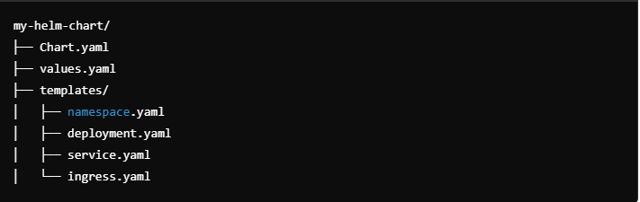
Helm Structure
Code
Deploy
Plan
Build
Release
Operate
Plan
Test
Monitor

Slide 38

Grafana
Code
Deploy
Plan
Build
Release
Operate
Plan
Test
Monitor
Visualizes real-time system metrics and logs with customizable dashboards.
Supports data sources like Prometheus, AWS CloudWatch, and more.
Alerts on key system metrics (CPU, memory, network, application health).
Enables proactive monitoring of applications and infrastructure.
Essential for ensuring system uptime, performance, and troubleshooting.

Slide 39
Share Your Practice
Code
Deploy
Plan
Build
Release
Operate
Plan
Test
Monitor
Images reveal large amounts of data, so remember: use an image instead of long texts

Slide 40
4
Summary
Let’s Summarize

Slide 41
Source Code
Version Control
Infrastructure as Code
Provisioning
Configuration Management
Code
Deploy
Plan
Development
Automation
Build
Dev
Release
Ops
Virtualization
Containerization
Operate
Plan
Test
Monitor
Continuous Integration/ Continuous Delivery or Deployment (CI/CD)
Visualisations
Logging
Quality Control

Slide 42
Any Questions ?
Now we can happily take all your questions

Slide 43
Thanks to

Slide 44
Special Thanks to
Eng. Ahmed Nourallah

Slide 45
Thanks!
For our LinkedIn links Omar Barakat: HERE Mohamed Samy: HERE Mustafa Ali: HERE Bola Wagdy: HERE Thomas Sedhom: HERE

